Slide 1
PPT ON CHATBOT

Slide 2
HTML CODING OF CHATBOT
<html> <head> <meta charset="UTF-8"> <meta name="viewport" content="width=device-width, height=device-height, initial-scale=1.0, maximum-scale=1.0, user-scalable=no"> <title>Landbot | Convert a Landing Page into a Chatbot</title> </head> <body> <script SameSite="None; Secure" src="https://cdn.landbot.io/landbot-3/landbot-3.0.0.js"></script> <script> var myLandbot = new Landbot.Fullpage({ configUrl: 'https://landbot.site/v3/H-1319187-E17KJ1PQ0EI5QAW1/index.json', }); </script> </body></html>

Slide 3
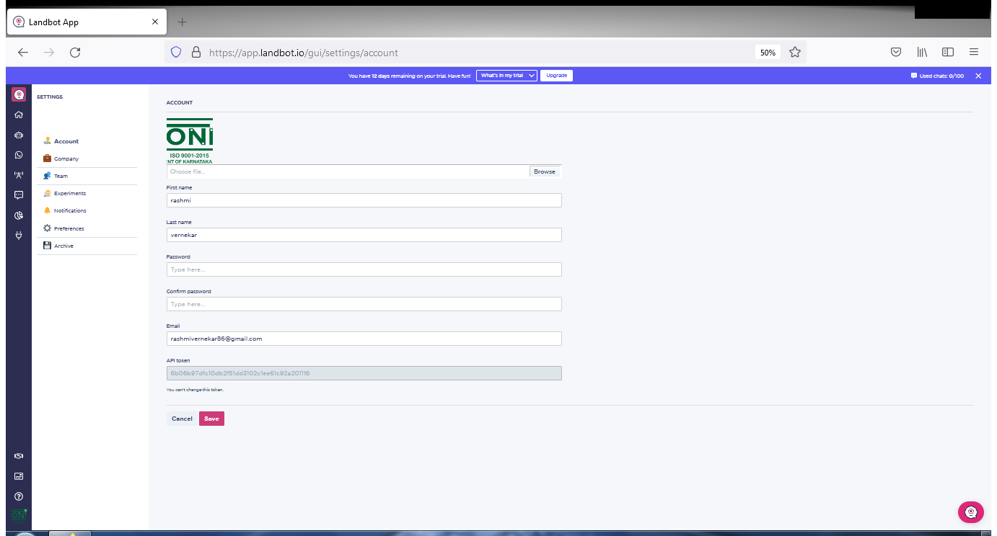
CHATBOT SCREEN SHORTS

Slide 4
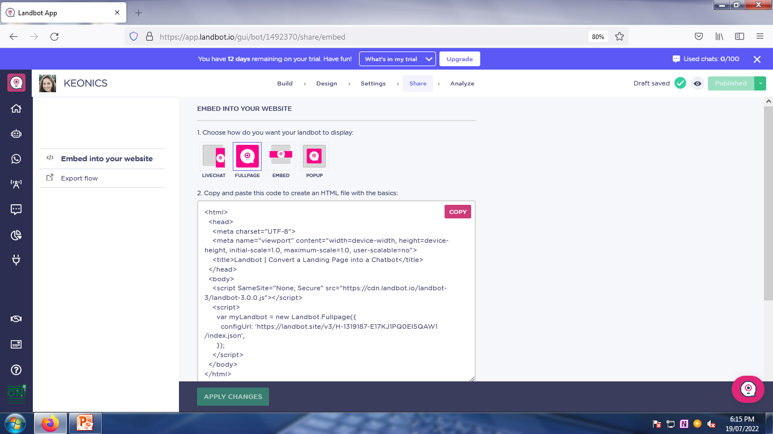
CHATBOT SCREEN SHORTS

Slide 5
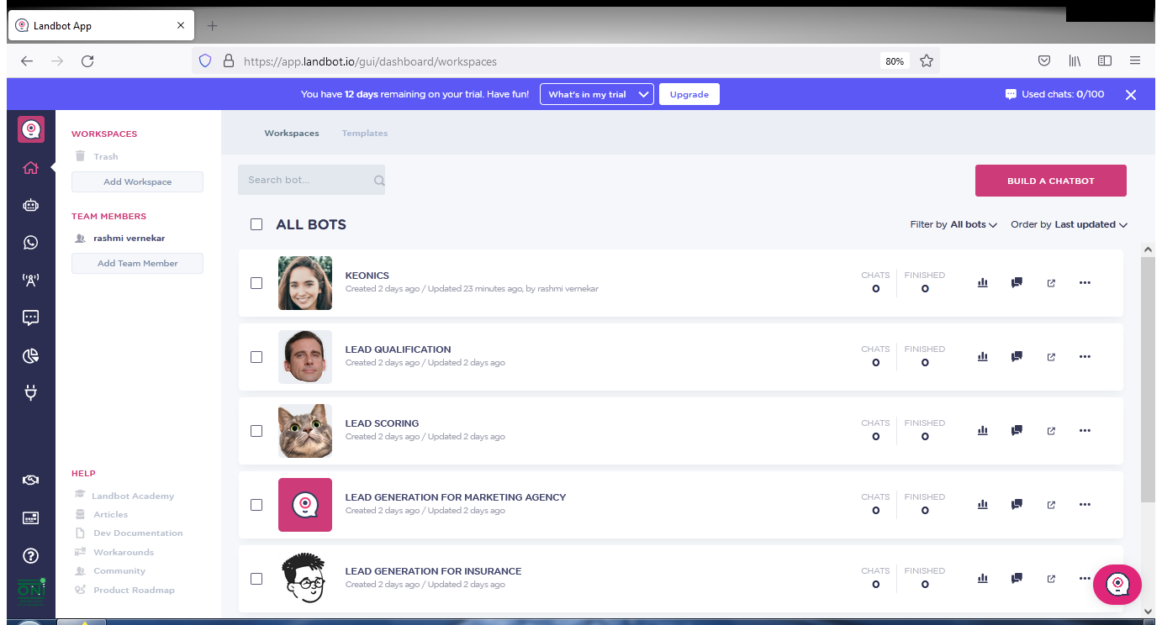
CHATBOT SCREEN SHORTS

Slide 6
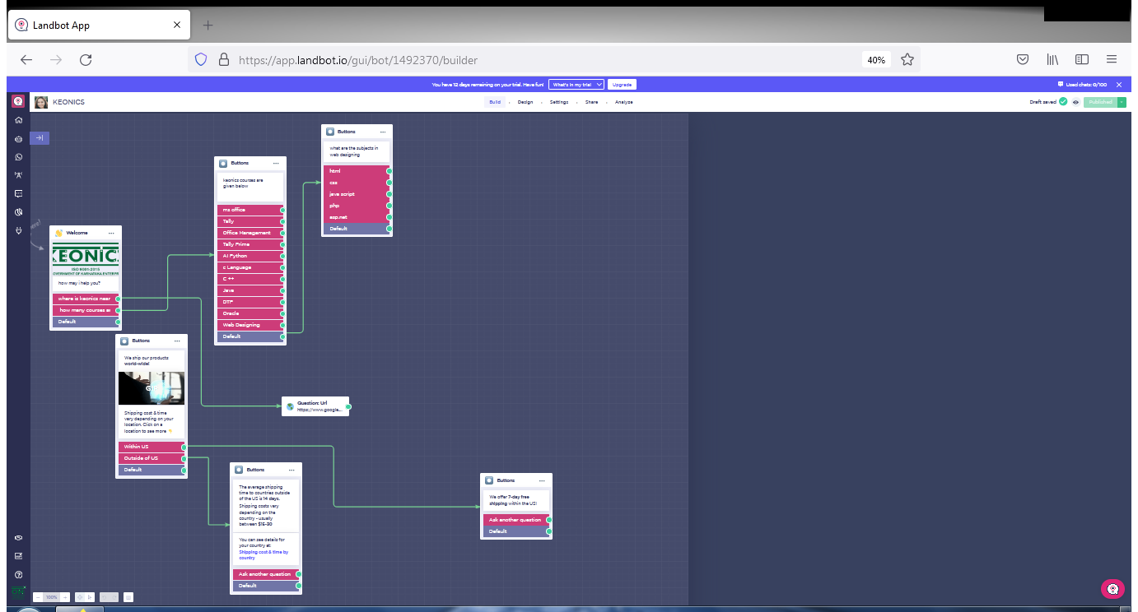
CHATBOT SCREEN SHORTS

Slide 7
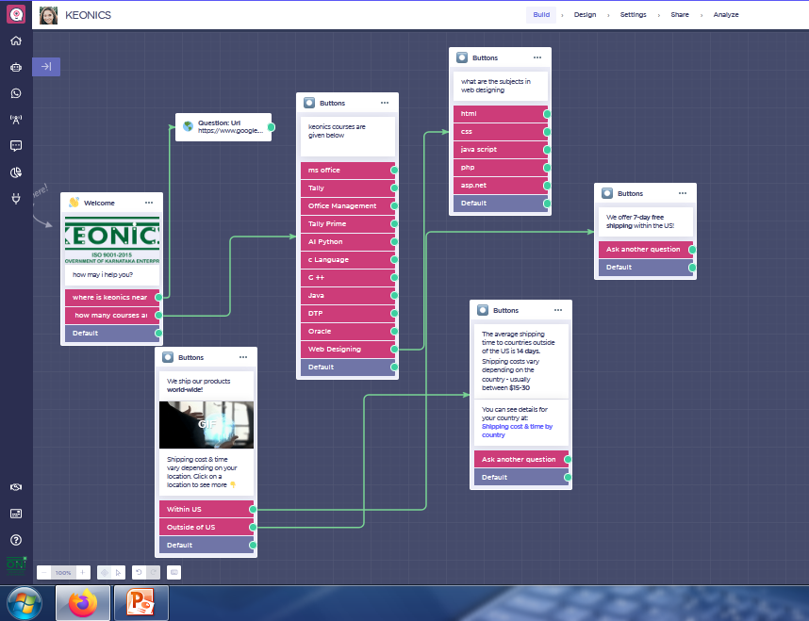
CHATBOT SCREEN SHORTS

Slide 8
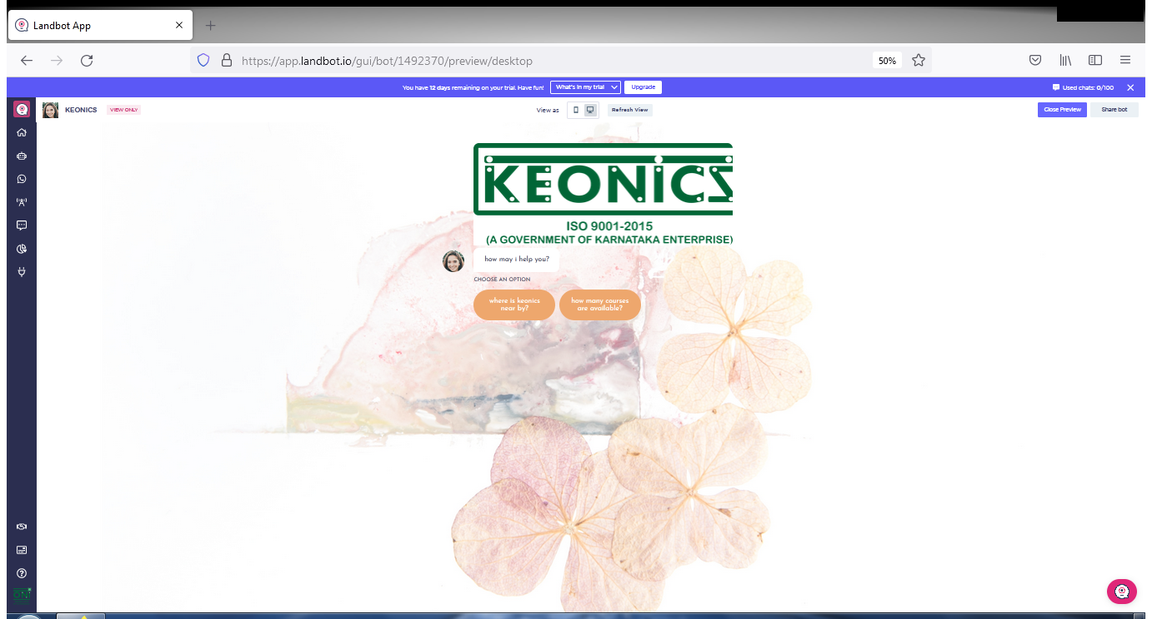
CHATBOT SCREEN SHORTS

Slide 9
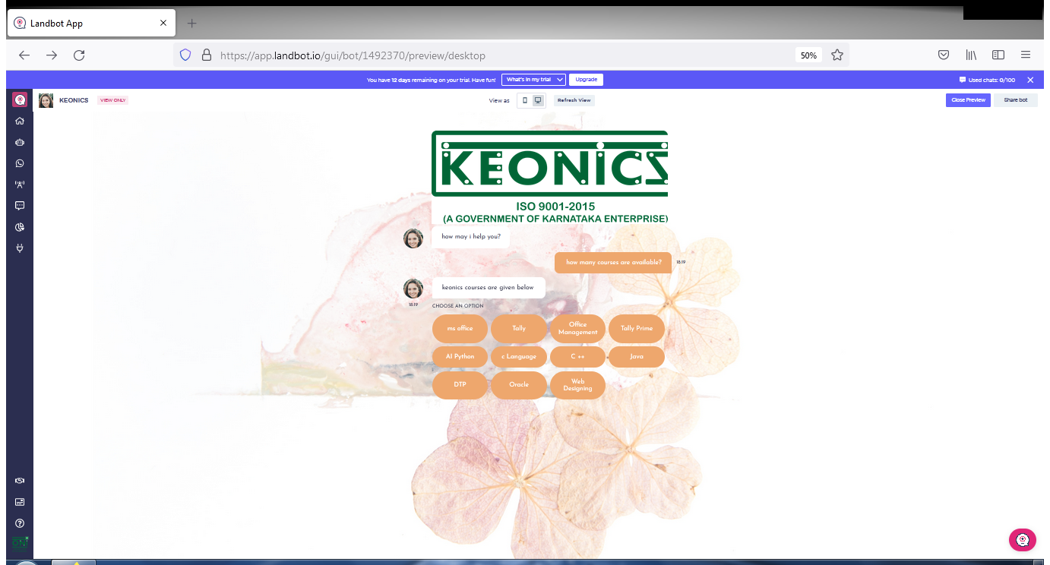
CHATBOT SCREEN SHORTS

Slide 10
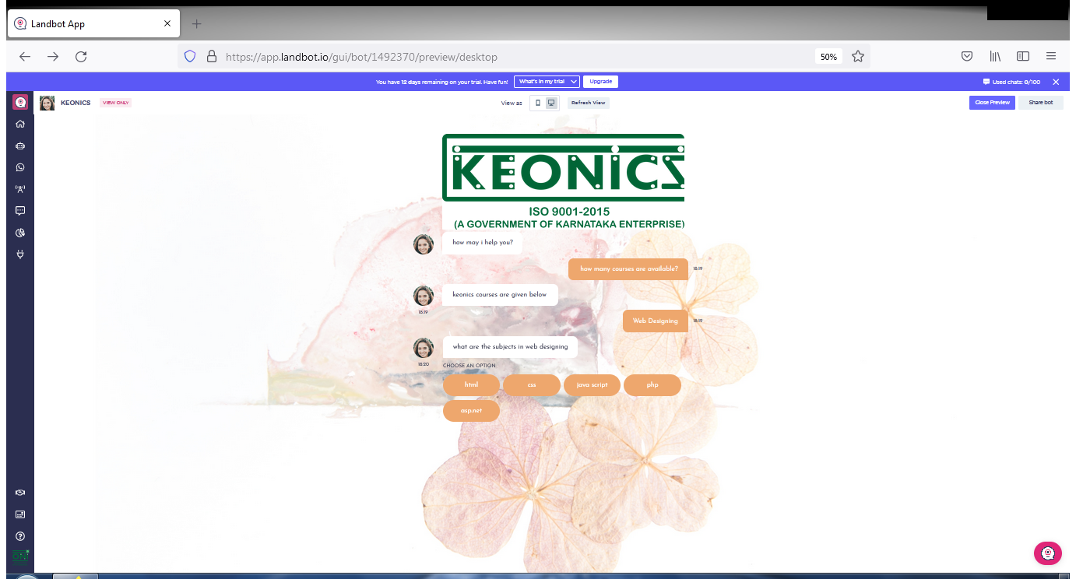
CHATBOT SCREEN SHORTS

Slide 11
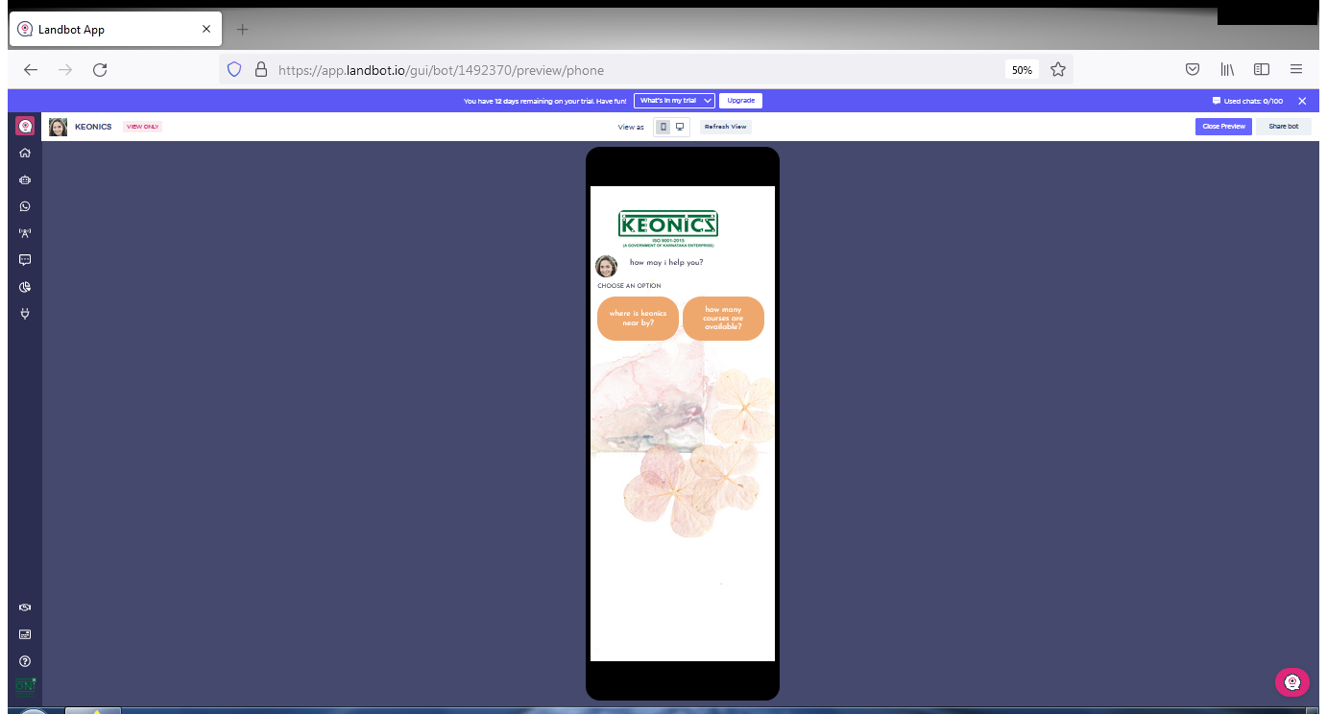
CHATBOT SCREEN SHORTS MOBILE VIEW

Slide 12
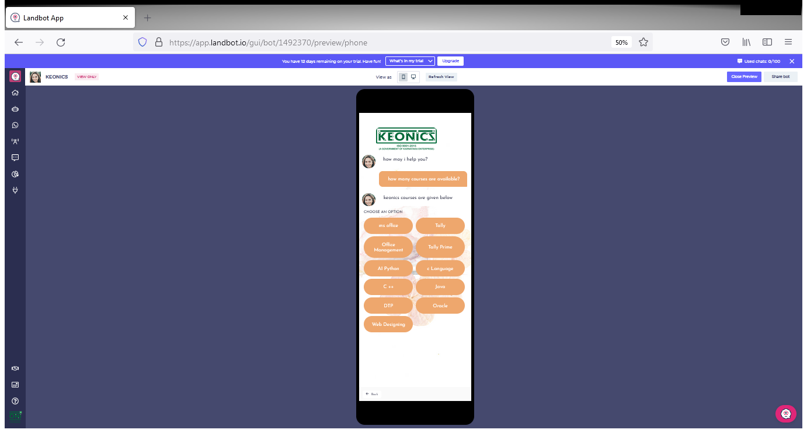
CHATBOT SCREEN SHORTS MOBILE VIEW

Slide 13
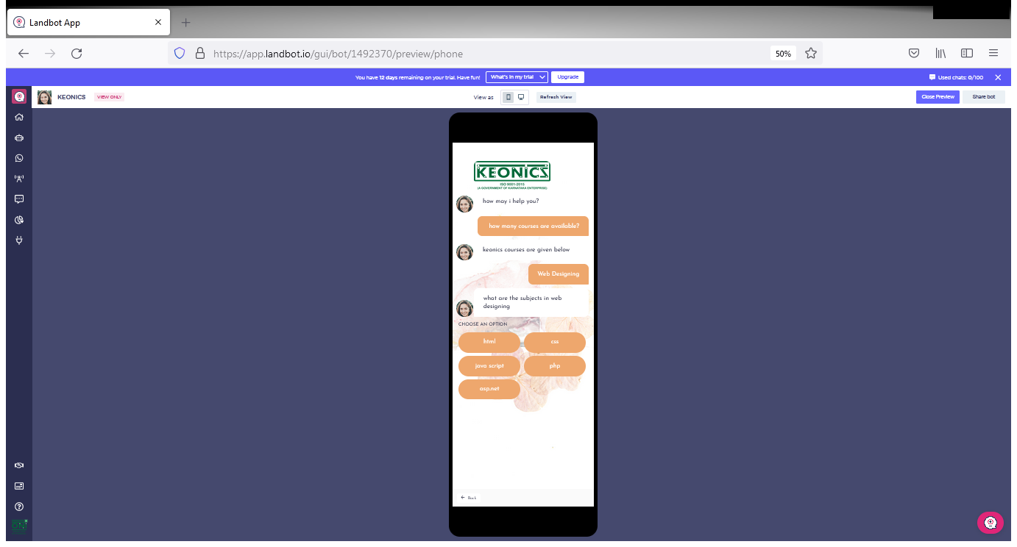
CHATBOT SCREEN SHORTS MOBILE VIEW

Slide 14
THANK YOU
Name of The Student:
Rashmi Vernekar
Keonics Computer Training Centre
It Park Hubli

